Slide 1

24/7
LIVE NEWS
LIVE
BREAKING
BrightTV (Viewership Analytics)
Insights & Recommendations for Subscription Growth
Presented by Victoria Lungu, May 2025

Slide 2


Outline
Key Lessons & Skills
Objective of the Project Development Process
Infographics on Viewership
Recommendations
Conclusion
03
04
05
5-10
11
12

Slide 3

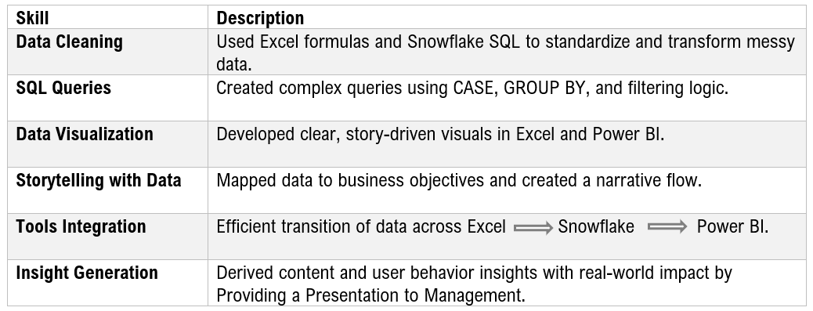

Key Learnings & Skills Developed

Slide 4

Objective of the Project
Focus of this Assignment
Provide actionable insights on BrightTV’s user and usage trends
Identify factors influencing content consumption
Recommend strategies to boost engagement and grow the subscription base
Exploring data insights

Slide 5
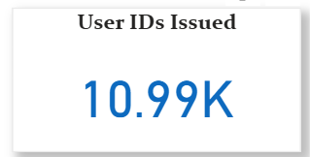




Viewership Infographic
10k
ACTIVE VIEWERS
Gender Distribution
Number of Viewers
87% of subscriptions are from females, despite females making up only 10% of the audience, with 3% of the data missing.
Over 10,000 viewership records analyzed to uncover audience trends by age group and preferred viewing times, providing reliable insights into user behavior.
3.7k
43%
Race Viewers
Popular Times
Of the 10k registered viewers, 4.3k are black men
Nighttime viewing accounts for nearly 38% of all viewership, making it the most popular time slot, followed by mornings at 27%.

Slide 6
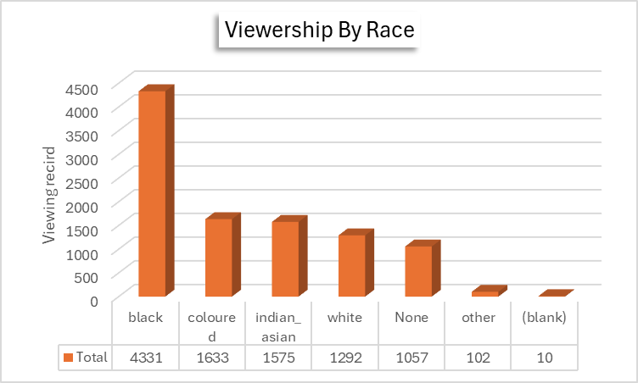
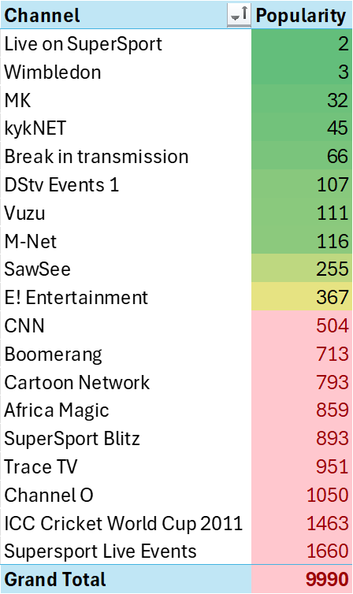
Most popular channel and race
The majority of viewers are Black (4,331), followed by Coloured (1,633), Indian/Asian (1,575), and White (1,292).
SuperSport Live Events is the most popular channel, followed by the ICC Cricket World Cup 2011, highlighting strong interest in live sports.

Slide 7
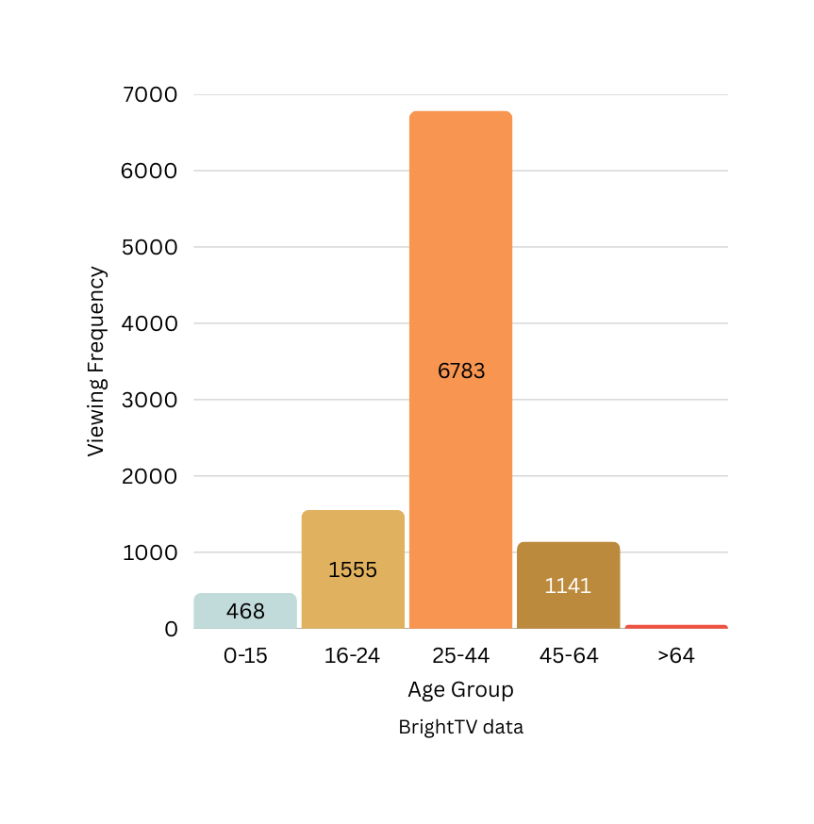
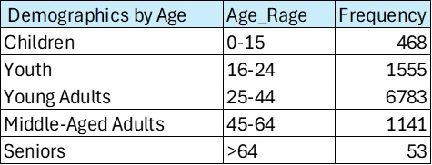
Audience Demographics by Age
Viewership by Age Group
Majority of viewers (6,783) are aged 25–44
Strong presence of 16–24 (1,555) and 45–64 (1,141) age groups
Fewer viewers under 15 (468) and over 64 (53)
BrightTV appeals mainly to young and middle-aged adults

Slide 8
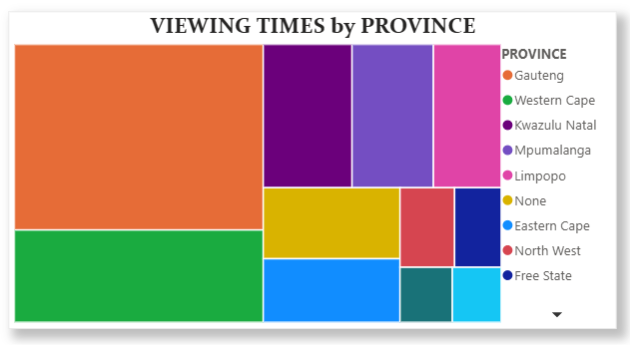
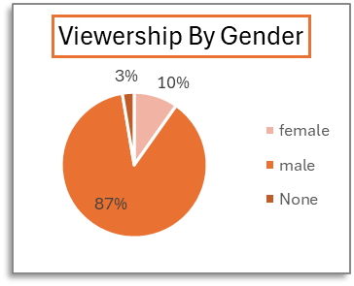
Viewership by Province and Age
Viewership by Gender
Male viewers make up the majority, accounting for 8,956 users.
Female viewers represent 1,026 users.
789 users have no gender information recorded, affecting data accuracy.
Viewership by Province
The treemap shows Gauteng with the highest viewership (3,751), followed by Western Cape (1,866) and Kwazulu-Natal (1,034).
Smaller audiences are seen in Northern Cape (234) and North West (353). Users with missing or unclassified locations (“None” or blank) total 1,007.
This highlights BrightTV’s strong presence in Gauteng and Western Cape, with growth opportunities in other provinces.

Slide 9
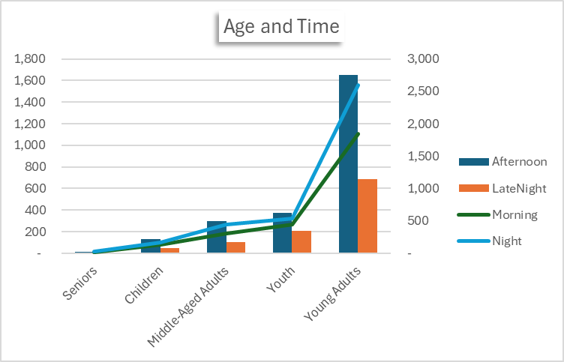

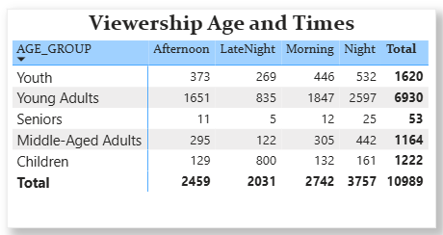
Viewership by Age
Young Adults are the largest viewers, especially at night and morning.
Night is the peak viewing time across all age groups.

Slide 10
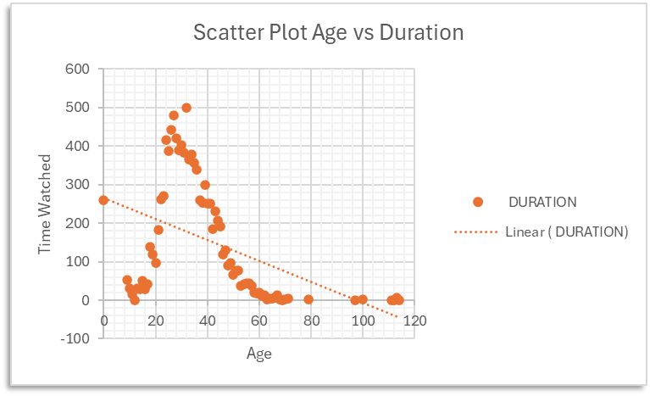
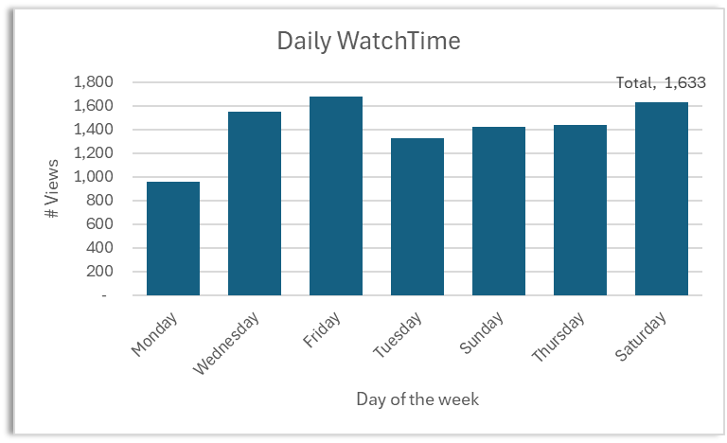
Duration and Day of the Week
The scatter plot shows Young Adults have the peak viewing duration across all time periods.
Friday and Saturday have the highest viewership.

Slide 11






Strategic Recommendations to Accelerate Business Growth
Boosting Engagement on Low Days
Initiatives to Grow User Base
Promote SuperSport Live Events and ICC Cricket World Cup 2011 on low-viewership days
Social media campaigns to increase outreach
Launch themed marathons or exclusive premieres on Mondays
Incentivize referrals and trial sign-ups to encourage uptake
Send targeted notifications to Young Adults and Youth segments
Partnering with ISPs and mobile providers to improve user experience

Slide 12

Conclusion & Next Steps
Key Takeaways
Data-driven insights can guide content and marketing strategies.
Focus efforts on high-potential user segments (e.g., Young Adults, sports fans.
Address data quality: inactive users inflate numbers and reduce accuracy.
Next Steps
Implement engagement and content recommendations.
Regularly monitor impact and adjust strategies.
Schedule quarterly database clean-up exercises to remove inactive users and ensure data accuracy.

Slide 13
Thank you !

